Slide 1
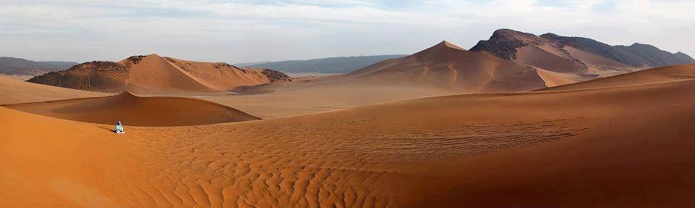
Reti e dinamiche migratorie
dei Tuareg del Mali
Alessandra Giuffrida
Associazione Lama?Ki / Fondazione Camis De Fonseca, 15 settembre e 24 ottobre 2021

Slide 2
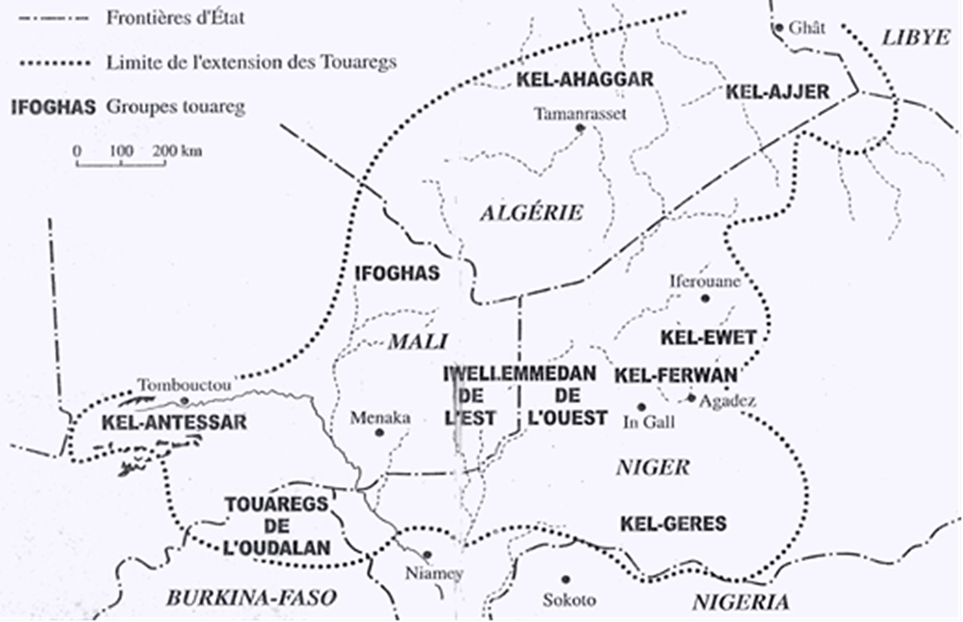
FEDERAZIONI DI CLAN TUAREG
(Casajus 2000:17)
Notes:
2

Slide 3
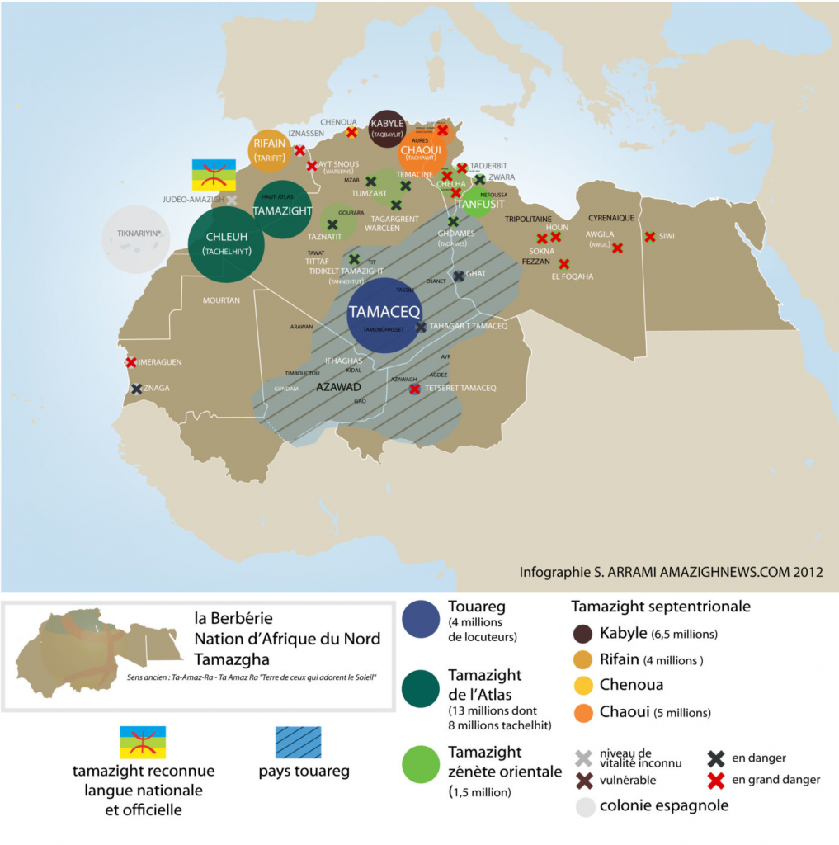
TAMAZGHA
Variazioni di berbero dei Tuareg:
. TAMAHAQ (tahaggart)
Algeria, Niger e Libia – Kel Ahaggar, Kel Ajjer
. TAMASHAQ (tadrart)
Mali - Kel Adrar, Ifoghas
. TAMAJAK (tayirt)
Niger - Kel Air
. TAMAJEK (tawellemmet)
Mali e Niger – Iwillemedden (Kel Ataram,Kel Denneg)

Slide 4
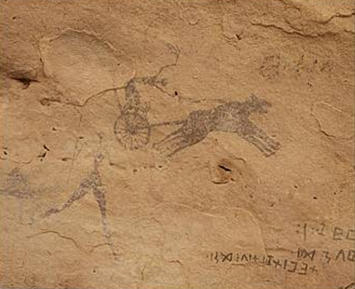
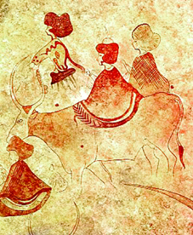
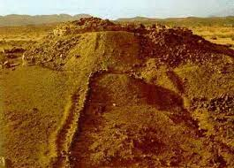
IL MITO DI TIN HINAN

Slide 5
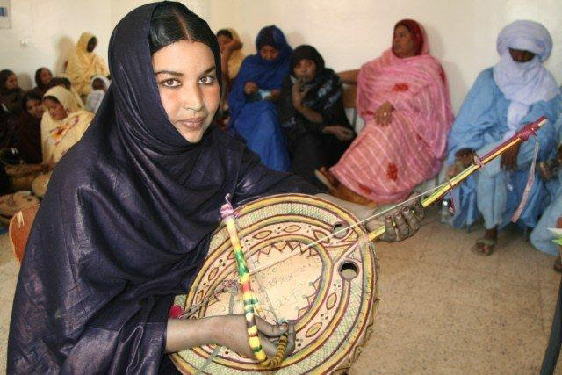
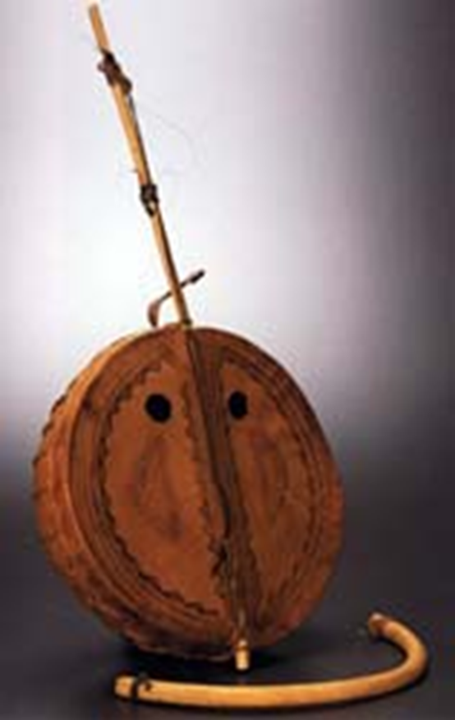
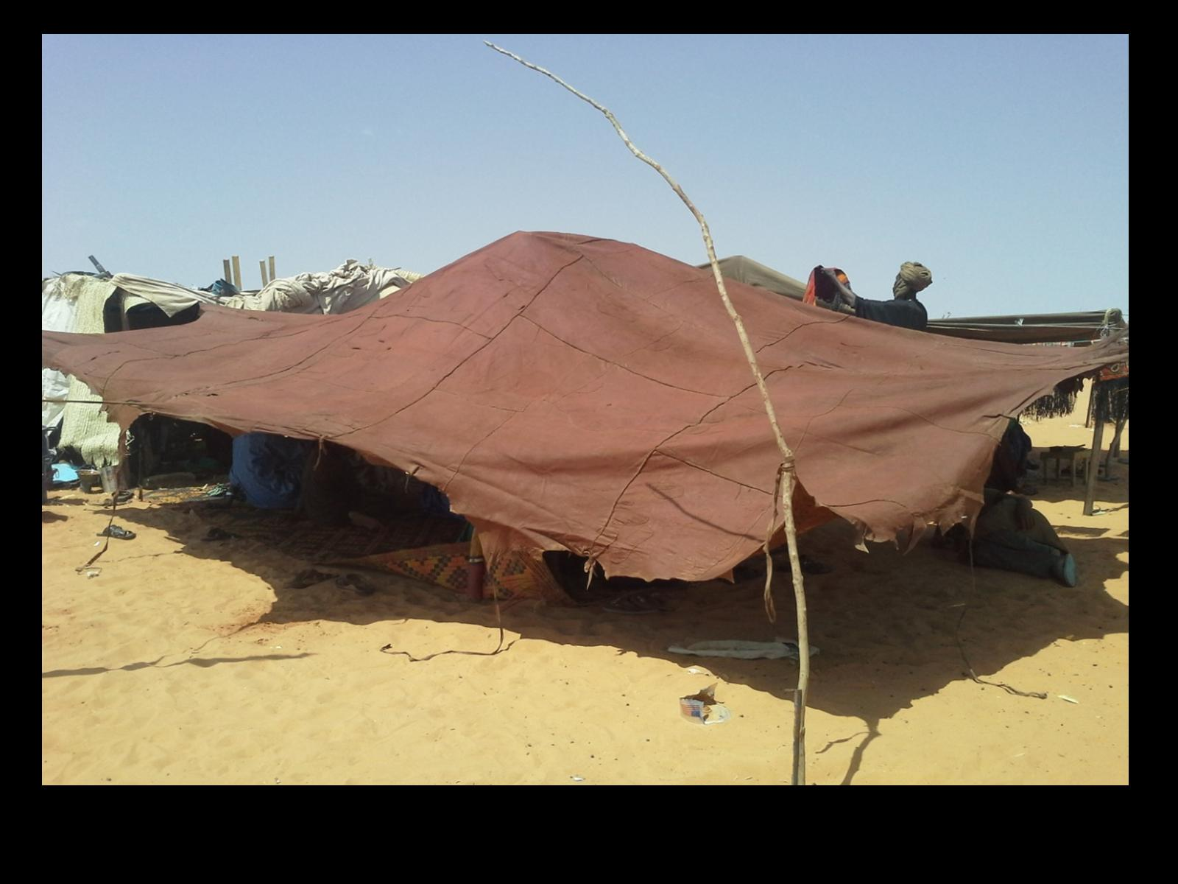

Slide 6
ORGANIZZAZIONE POLITICA TERRITORIALE
Amenokal (capo federazione di tribù o capo clan) Tawsit (clan) Ettebel (Tamburo)
Amazagh (Accampamento) - Sezione di un clan Amghar (Capo dell’Accampamento)
Ehan, Aghiwen (Gruppo di una o più tende) - Sezione di un lignaggio

Slide 7
STRATEGIE MATRIMONIALI E
STRUTTURA SOCIALE PRECOLONIALE
Imashaghen Guerrieri
Ineslimen / Imghad Tributari
Enhaden Artigiani
Eghawelen Ex-schiavi
Iklan Schiavi

Slide 8
INFLUENZA ISLAMICA
Mobilità sociale: casta dei religiosi musulmani (ineslimen), schiavi liberati (eghawelen)
Dinamiche migratore: insediamento, assimilazione, fusione, espulsione, innesto
Kel Antessar : - da tributari e capi di una confederazione
- giureconsulti, diplomatici, insegnamento coranico, guaritori
- conversione all’Islam per matrimonio
- strategie matrimoniali endogame e esogame
- discendenza bilineare (patrilineare e matrilineare)
Arabizzazione: lingua araba (scuole coraniche, fqui per affari commerciali e amministrazione)
Sincretismo: sufismo e credenze soprannaturali (kel essuf)

Slide 9
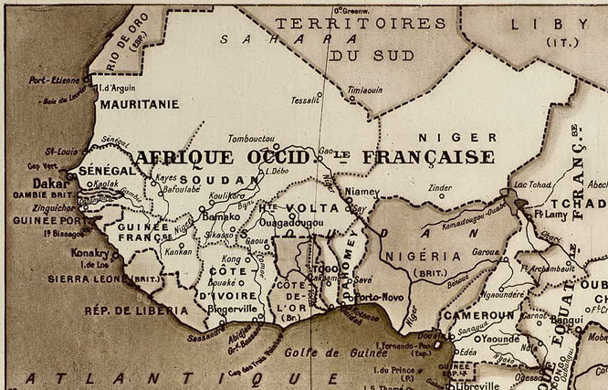
AFRICA OCCIDENTALE FRANCESE - AOF - (1895 - 1960)
Restrizioni alla mobilità del bestiame e dei commercianti tuareg (laissez-passer)
Politiche di sendentarizzazione (terroirs d’attache, frazioni amministrative, chefs coutumiers)
- Diviser pour regner
- Scolarizzazione francese
- Villages de liberté
- Frammentazione politica
- Sedentarizzazione
Notes:
9

Slide 10
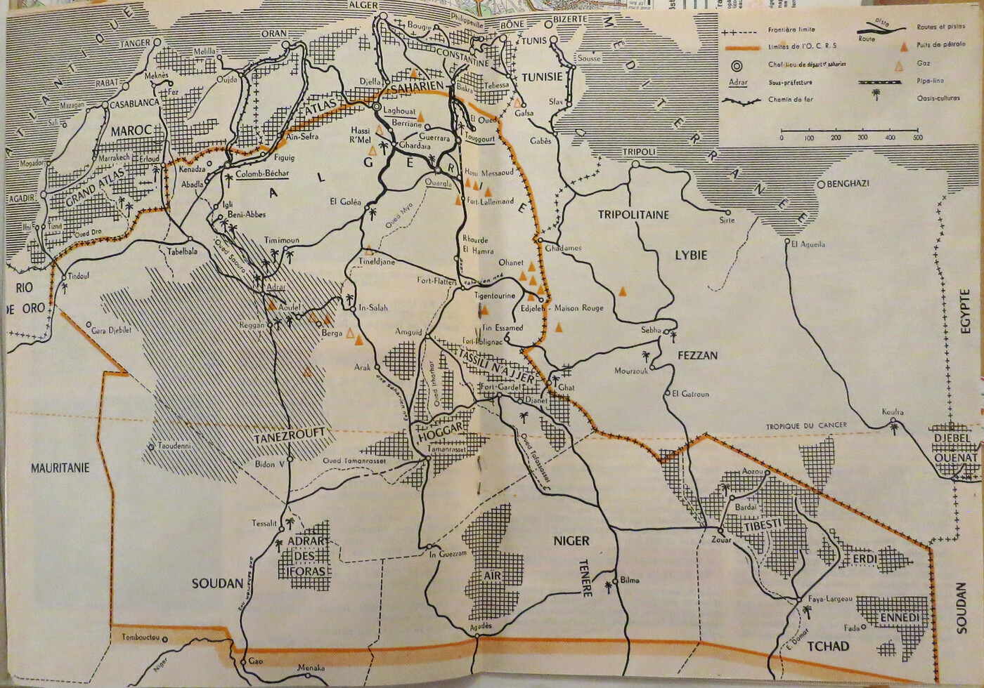
ORGANISATION COMMUNE DES REGION SAHARIENNES (OCRS)

Slide 11
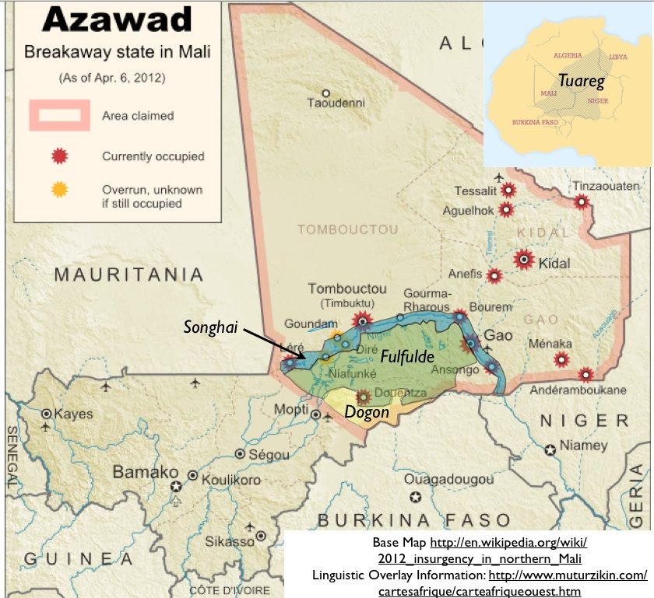
ORGANISATION COMMUNE DES REGION SAHARIENNES (OCRS)

Slide 12
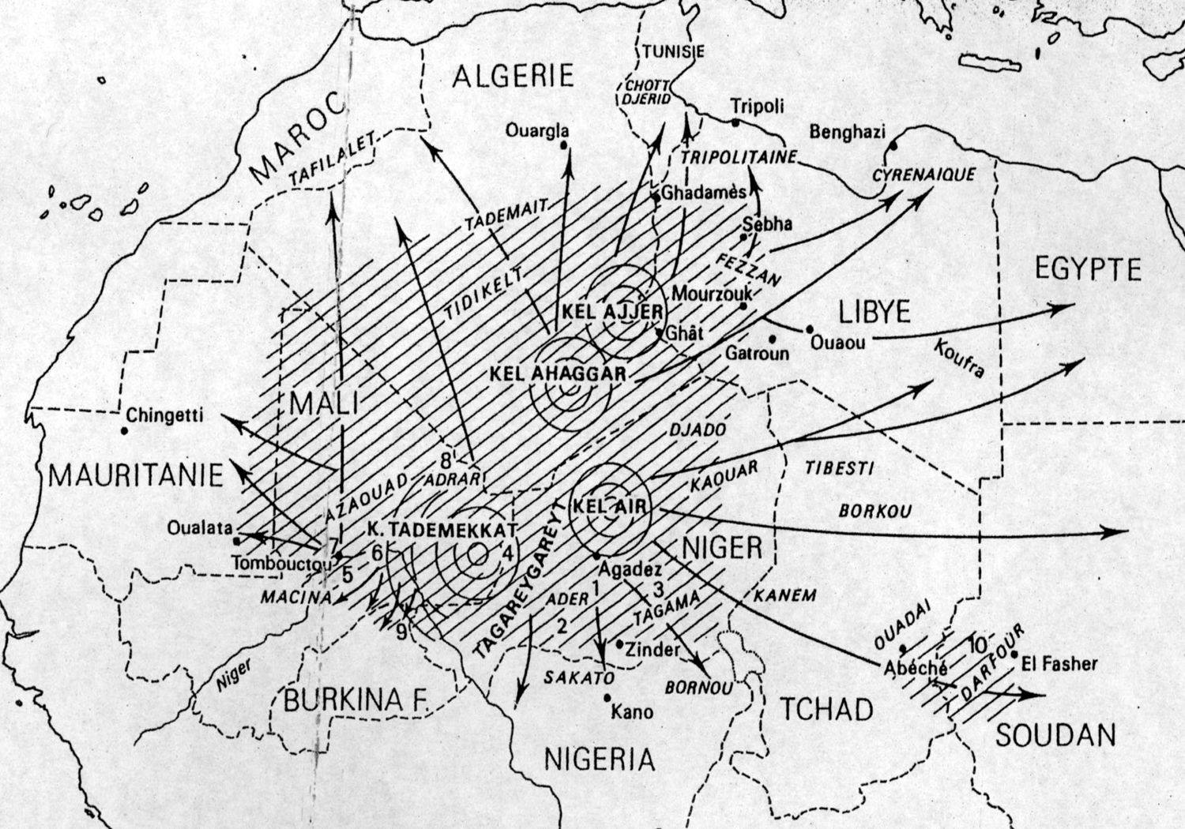
DIASPORA TUAREG
1960-68 Indipendenza del Mali (Prima repubblica)
1968-90 Regime militare
1992 -2002 (AOK)
Seconda Repubblica
2002 – 2012 (ATT)
Terza Repubblica
2013 -2020 (IBK)
Colpi di stato militari in Mali:
1968, 1991, 2013, 2020
Ribellioni tuareg:
1963, 1990, 2006, 2012
Claudot-Hawad 1996:36
Notes:
Following the 1984 drought which further reduced the size of herds, large numbers of Tuareg pastoralists were forced to settle and survive with very small herds that could hardly ensure a minimum level of subsistence. This implied combining a sedentary and semi-sedentary way of life. The pattern that emerged was that while a household settles in a settlement near a well with only a few animals to have daily milk supplies, other related members of the same household follow the family herd and move around the settlements. During the dry season, the latter return to the settlement to access water from the well. This combined sedentary and mobile way of life continues to be a prevalent pattern at the present time and reproduces the pattern of stasis and movement which I have mentioned in relation to the villages of freedom and the creation of French schools. Interestingly, during the rebellion whilst refugees lived in refugee camps, displaced pastoralists moved around with their tents and herds and exchanged their cereal provisions from their refugee relatives for milk and butter. This pattern was still noticeable during fieldwork.
Although the agrarian reform and droughts put pressure on the availability of agricultural land, a large part of the Tuareg in northern Mali migrated to different countries in search of employment opportunities and political asylum. After the 1963 Tuareg rebellion and the 1970s and 1980s droughts, Tuareg migratory movements started in the direction of Morocco, Mauritania, Algeria and Libya but also to Senegal, Ivory Coast, Burkina Faso and Benin and to East Africa, Chad, Egypt and the Sudan. In 1980, when Colonel Ghaddafi declared Libya the ‘homeland’ of all Tuareg and offered them the opportunity to join the lower ranks of the Islamic Legion, Tuareg immigrants and exiles (ishumaren) who found themselves in Libya were naturalised as Libyan nationals, thus gaining the necessary identification papers to cross borders legally.
12

Slide 13
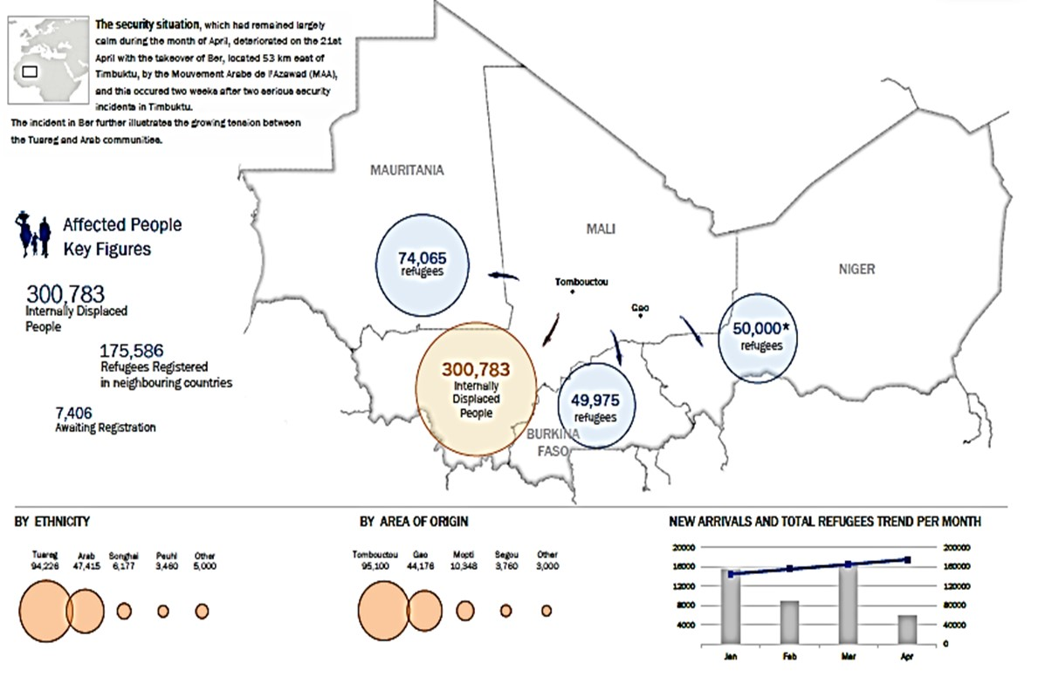
ESODO RIFUGIATI E SFOLLATI MALIANI (UNHCR, 2013)

Slide 14
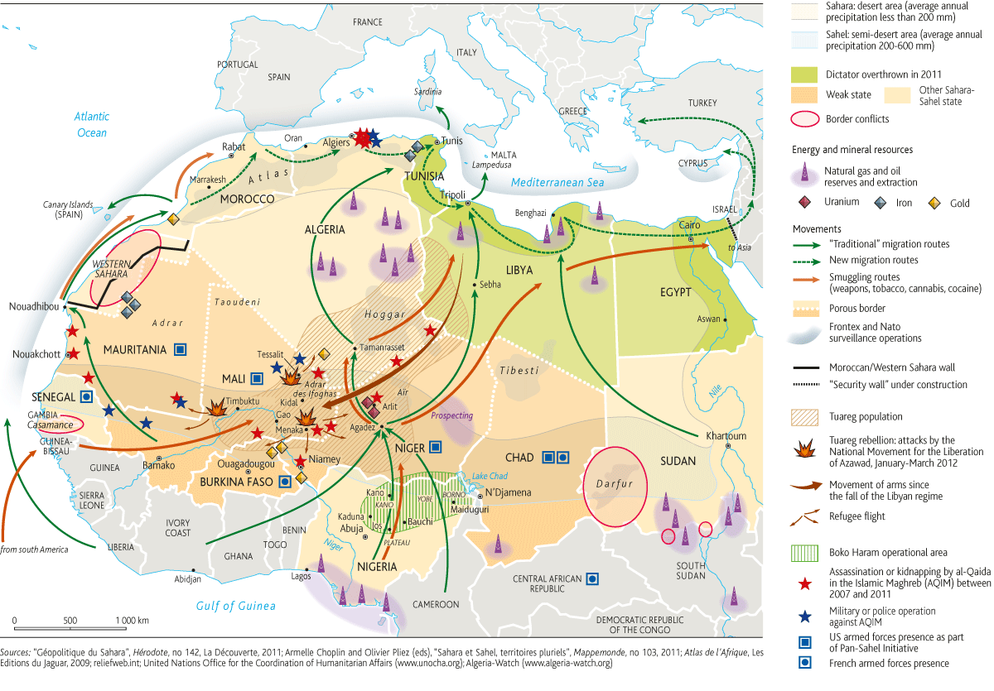

Slide 15
